Slide 1
UNIT ONE – Part One

Slide 2
MANAGEMEN T
Team work
Tasks
Time
Tactics
Transparent
Tools
Tracking
Testing
Target

Slide 3
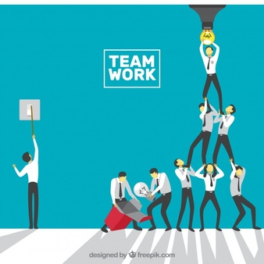
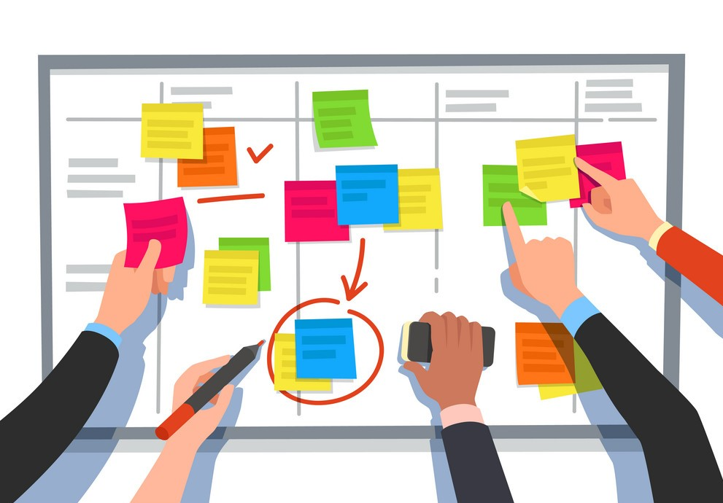

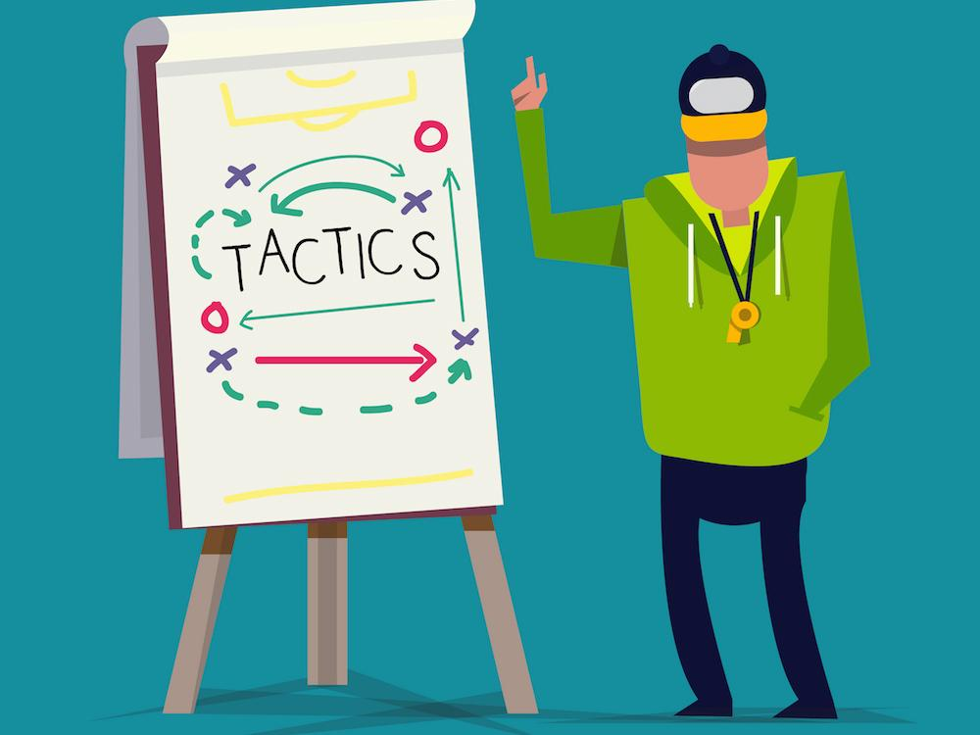

Slide 4
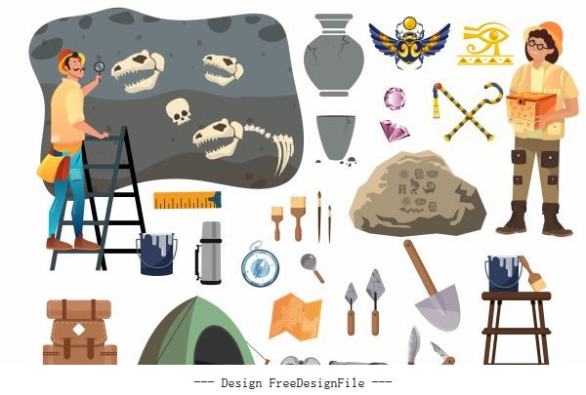


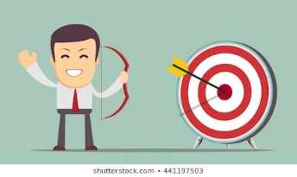

Slide 5
MANAGE Men T
Men/Women
Material
Machines
Methods
Money
Minute
Measurement

Slide 6
Organization- The Individual and the Organization
A consciously coordinated social unit, composed of two or more people, that functions on a relatively continuous basis to achieve a common goal or set of goals.
An organization is a collection of people working together to achieve a common purpose. It is a unique social phenomenon that enables its members to perform tasks far beyond the reach of individual accomplishment.

Slide 7
Common Characteristics of Organizations
Have a distinct purpose (goal)
Are composed of people
Have a deliberate structure

Slide 8
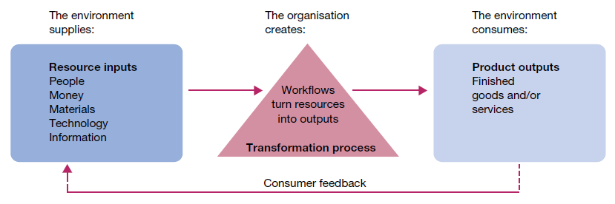

Slide 9
The changing nature of organizations
Pre-eminence of technology.
Demise of ‘command-and-control’.
Focus on speed.
Adoption of networking.
Belief in empowerment.
Emphasis on teamwork.
New workforce expectations.
Concern for work–life balance.

Slide 10
The Changing Organization
Traditional
Stable
Inflexible
Job-focused
Work is defined by job positions
Individual-oriented
Permanent jobs
Command-oriented
Managers always make decisions
Rule-oriented
Relatively homogeneous workforce
Workdays defined as 9 to 5
Hierarchial relationships
Work at organizational facility during specific hours
New Organization
Dynamic
Flexible
Skills-focused
Work is defined in terms of tasks to be done
Team-oriented
Temporary jobs
Involvement-oriented
Employees participate in decision making
Customer-oriented
Diverse workforce
Workdays have no time boundaries
Lateral and networked relationships
Work anywhere, anytime

Slide 11
Management- Primary Functions of Management
Management is the process of designing and maintaining an environment in which individuals, working together in groups, efficiently accomplish selected aims

Slide 12
Van Fleet and Peterson define management, ‘as a set of activities directed at the efficient and effective utilization of resources in the pursuit of one or more goals.’
to Harold Koontz, ‘Management is an art of getting things done through and with the people in formally organized groups. It is an art of creating an environment in which people can perform and individuals and can co-operate towards attainment of group goals.‘

Slide 13
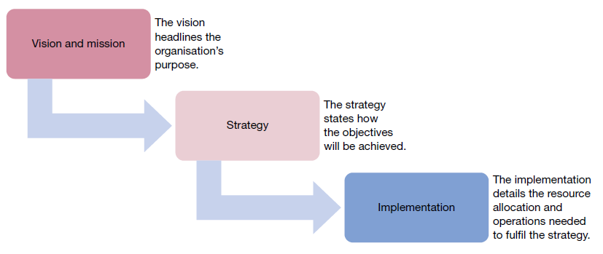
Process of Management

Slide 14
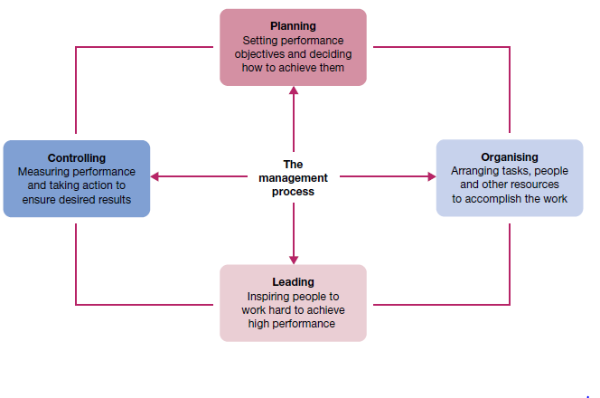
Functions of Management

Slide 15
Functional Approach
Planning
A process that includes defining goals, establishing strategy, and developing plans to coordinate activities.
Organizing
Determining what tasks are to be done, who is to do them, how the tasks are to be grouped, who reports to whom, and where decisions are to be made.
Leading
A function that includes motivating employees, directing others, selecting the most effective communication channels, and resolving conflicts.
Controlling
Monitoring activities to ensure they are being accomplished as planned and correcting any significant deviations.

